Slide 1

Tableau Sharing
Fundamental

Slide 2
CHAPTER 1
Introducing Visualization and Tableau

Slide 3
Why data visualization?
Data Visualization Amplifies Your Messaging
Data Visualization Provides Clearer Understanding
Data Visualization Aids Decision Analysis

Slide 4
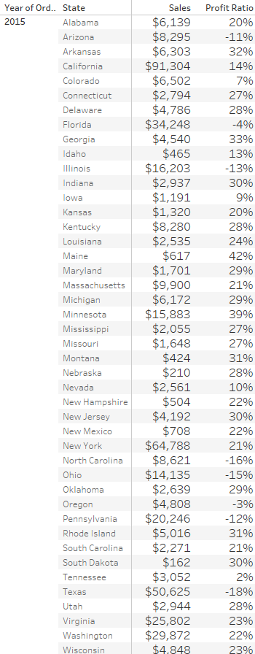
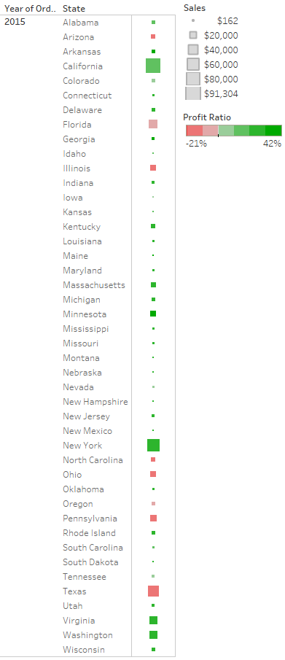
Word
Visualization
VS

Slide 5
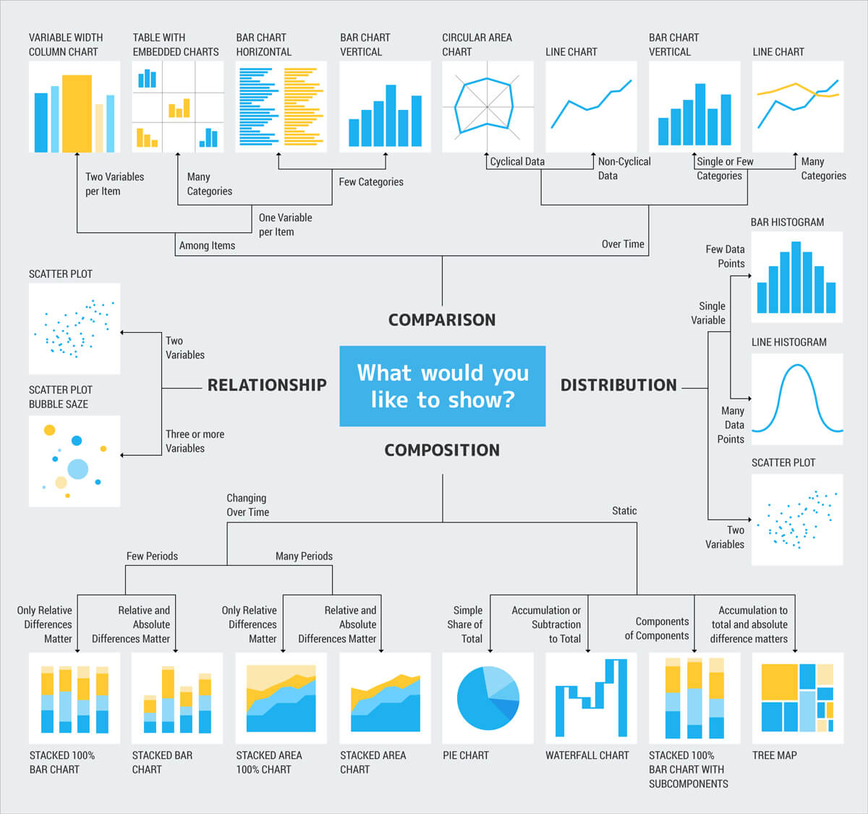
Introduction Visualization

Slide 6
What can data visualization help with?
Data visualization helps people to understand things clearly and have a better insight into the topic
Data visualization helps to predict future easily and take better decisions
Data visualization conveys the information in a universal manner
It makes it simple to share ideas with others
Data visualization lets people know where they need to do an adjustment in their business to get a better result

Slide 7
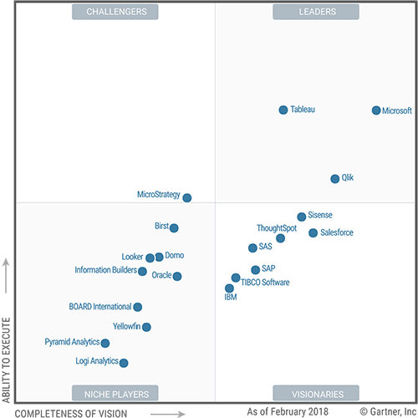
Positioning of Tableau

Slide 8
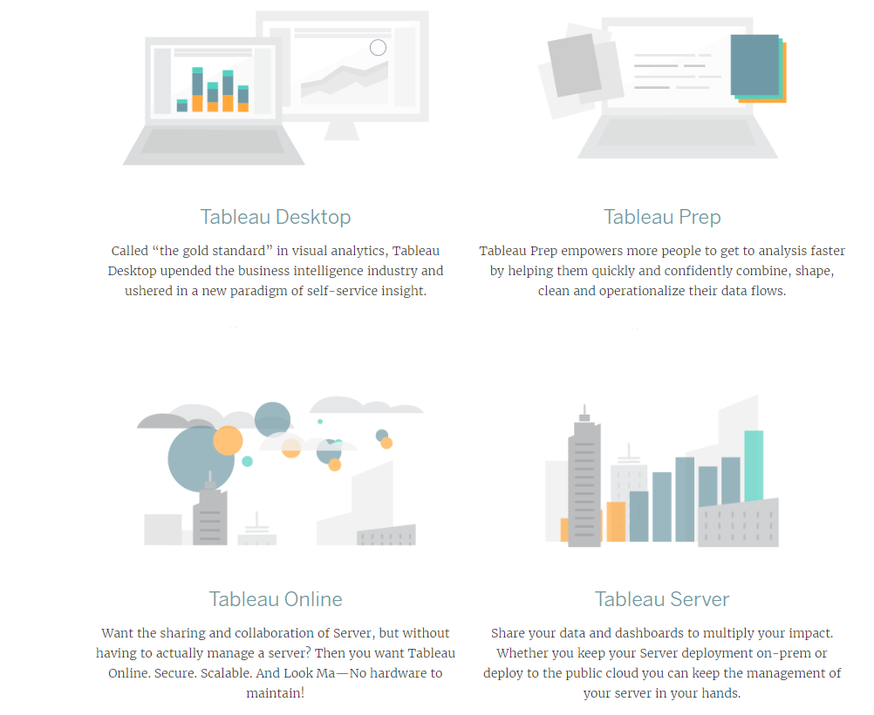
Tableau Product Line

Slide 9
File Type in Tableau
Workbooks (.twb) :
Workbooks hold one or more worksheets, plus zero or more dashboards and stories.
Bookmarks (.tbm) :
Bookmarks contain a single worksheet and are an easy way to quickly share your work. For more information.
Packaged Workbooks (.twbx):
A packaged workbook is a single zip file that contains a workbook along with any supporting local file data and background images.

Slide 10
Extract (.hyper or .tde) :
Extract files are a local copy of a subset or entire data set that you can use to share data with others, when you need to work offline, and improve performance.
Data Source (.tds) :
Data source files are shortcuts for quickly connecting to the original data that you use often.
Packaged Data Source (.tdsx) :
A packaged data source is a zip file that contains the data source file (.tds) described above as well as any local file data such as extract files (.hyper or .tde), text files, Excel files, Access files, and local cube files.

Slide 11
CHAPTER 2
Working with single data source

Slide 12
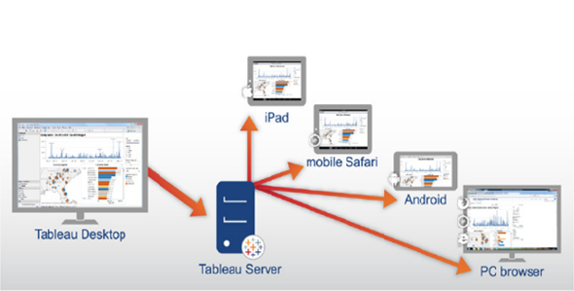
Desktop Architecure

Slide 13
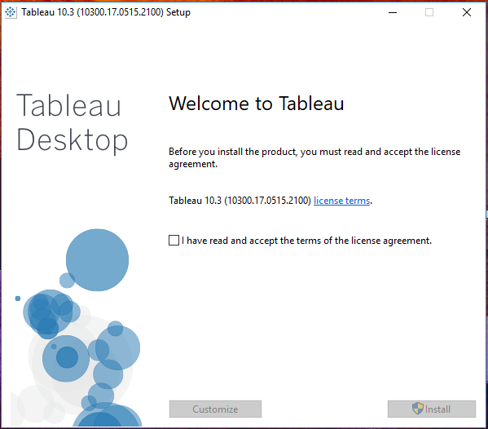
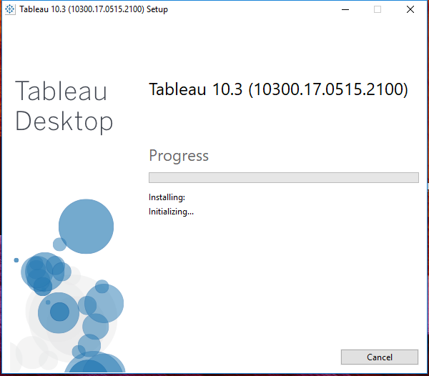
Tableau Destop Installation
Step 1. Download Tableau Desktop
Step 2. Run .exe file and wait process until finish

Slide 14
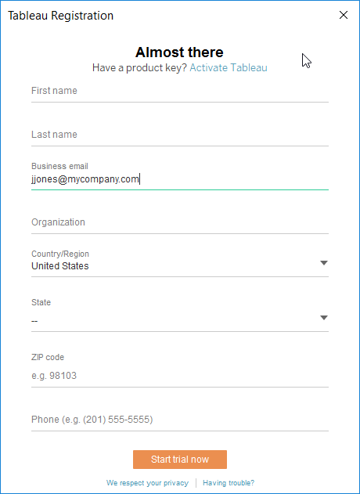
Tableau Destop Activation
1. After the installation process is finished, open Tableau Desktop. This launches the Tableau Registration form where you can register and activate your product.
2. Fill out the fields on the registration form and then click Activate Tableau or start trial now.

Slide 15
Tableau Destop Environment
Tableau has three page Environment as below
Start Page
Tableau Workspace
Data Source Page

Slide 16
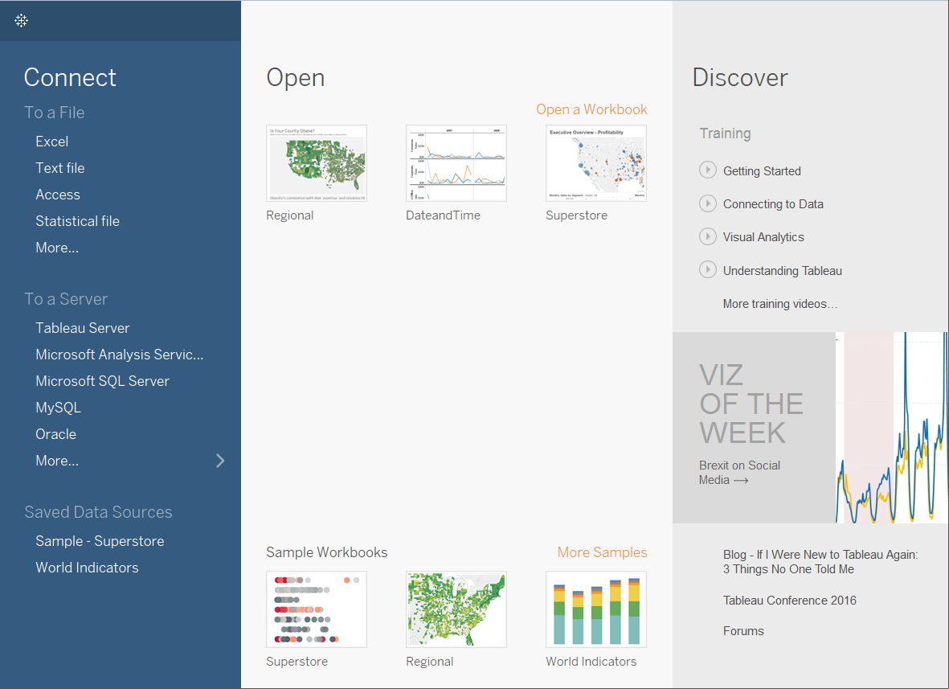
Start Page
The start page in Tableau Desktop is a central location from which you can do the following:
Connect to your data
Open your most recently used workbooks, and
Discover and explore content produced by the Tableau community

Slide 17
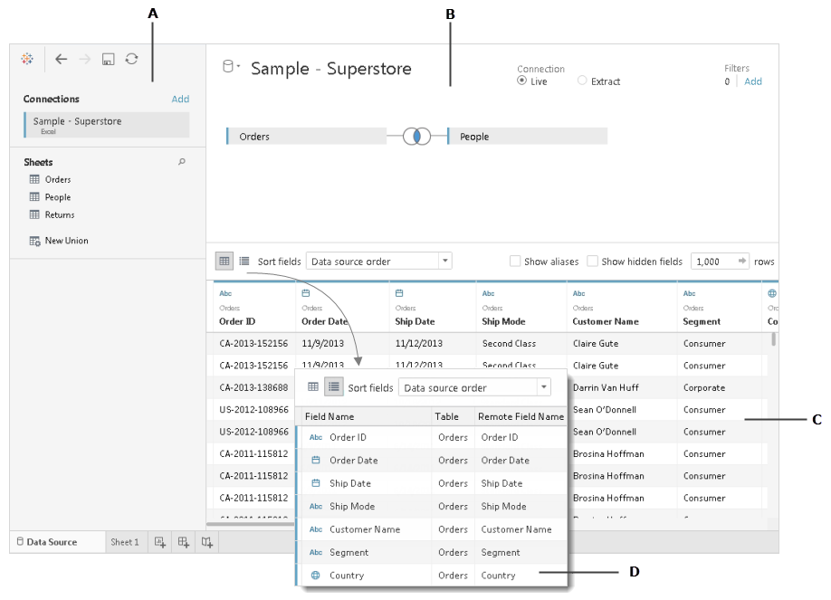
Data Source Page
A. Left pane
B. Canvas
C. Data grid
D. Metadata grid

Slide 18
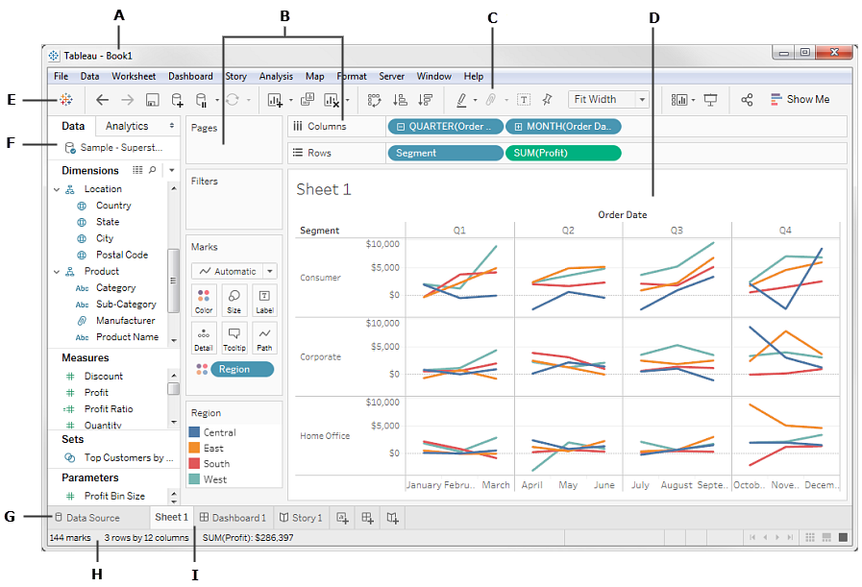
Tableau Workspace
A. Workbook name.
B. Cards and shelves
C. Toolbar
D. View
E. Tablaeu Icon (go to Start Page)
F. Side Bar
G. Data Source (go to Data Source Page)
H. Status bar
I. Sheet tabs

Slide 19
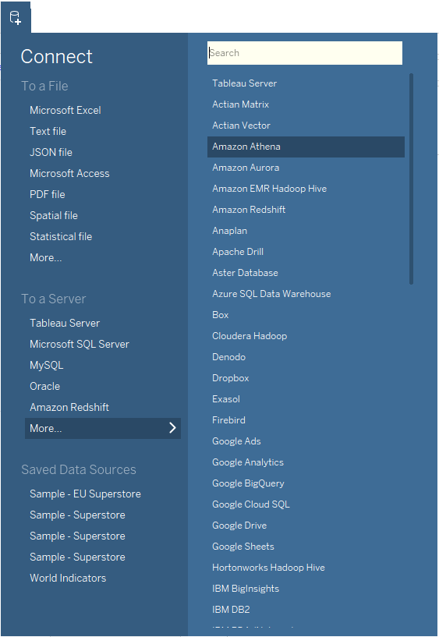
Connect to Data
Step1 : Click New Data Source icon at toolbar menu.
Step2 : Select Data Source Type that will used (for this case select microsoft excel)

Slide 20
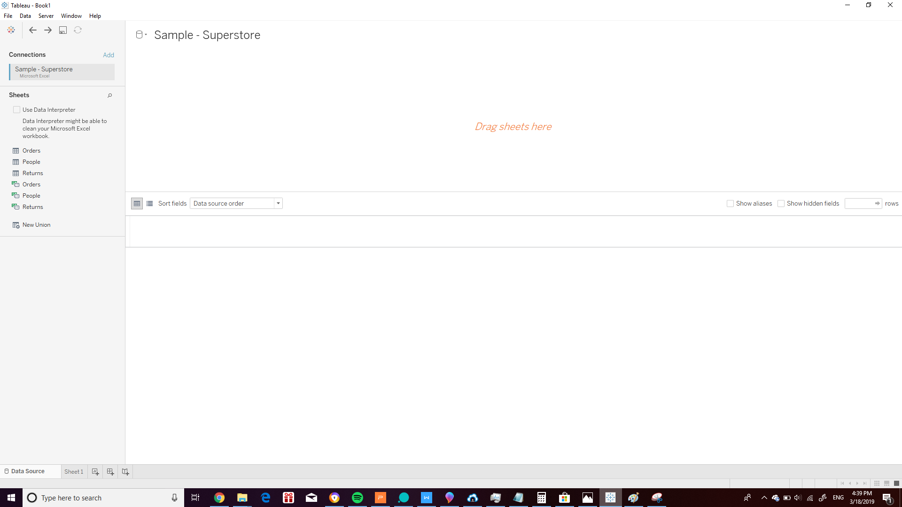
Step3 : After Selecting microsoft excel data source type -> open Sample - Superstore.xls file
Tableau will Show Data source page and table/sheet from Sample - Superstore.xls file within as below:

Slide 21
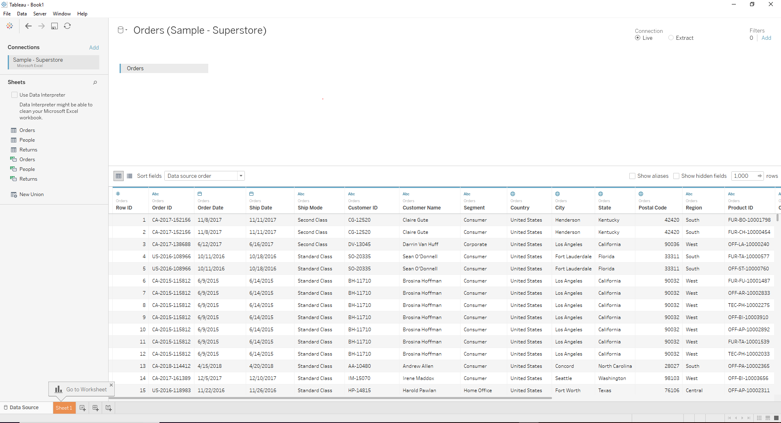
Step4 : Drag Orders Sheet to Canvas(there is Drag sheets here word)
Tableau will show data on data grid as below:

Slide 22
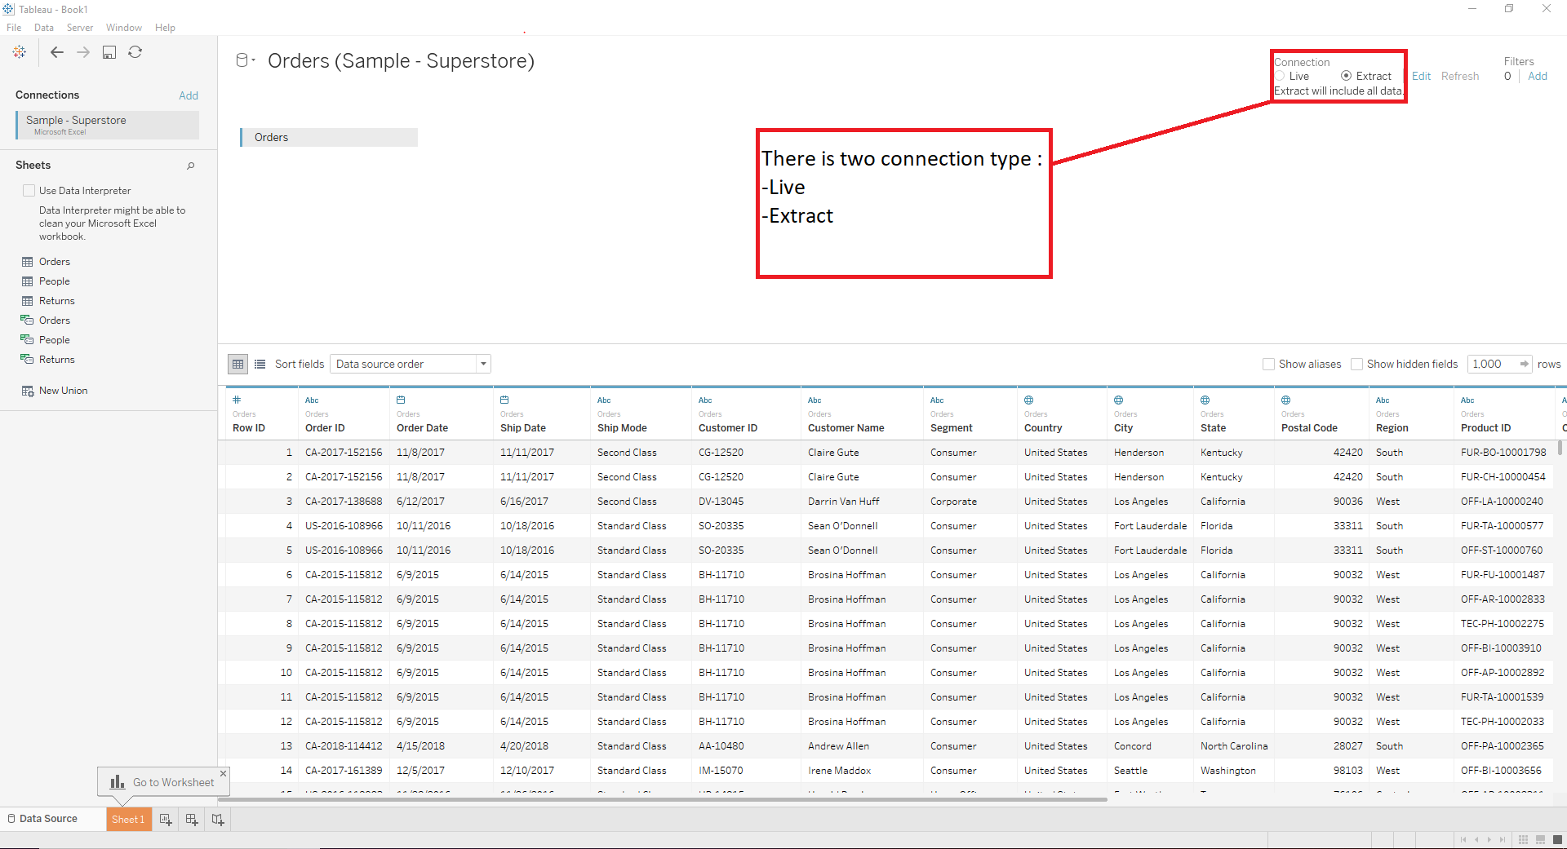
Step5 : Select Extract connection type

Slide 23
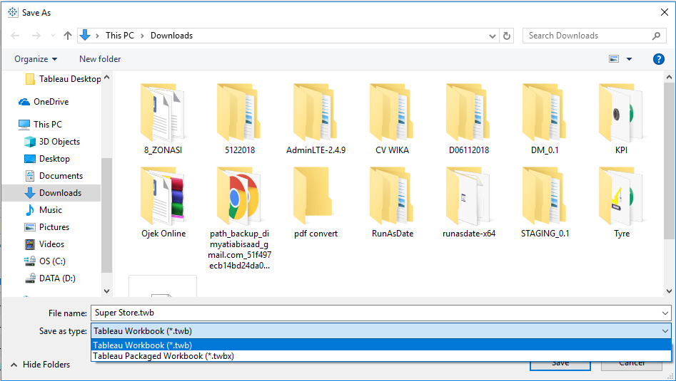
Step6 : Save workbook with name super store by click file menu => save or Ctrl + S
Step7 : Choose Save as Type .twb (Tableau Workbook) or .twbx (Tableau Package Workbook)

Slide 24
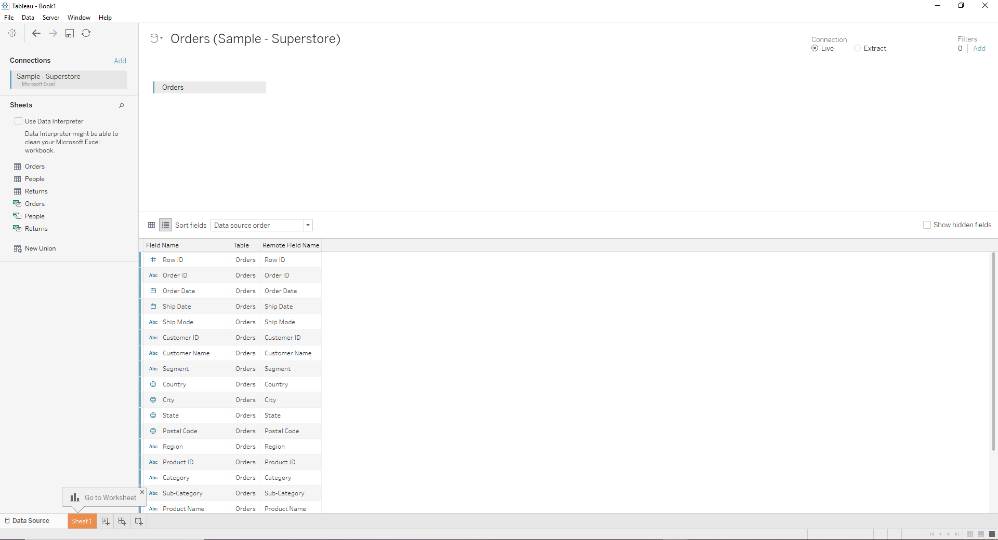
Metadata Grid
Tableau also provides a feature Metadata Grid for easier viewing of metadata from connected data sources
Click icon Manage Metadata icon at data source page and meta data will show as below:

Slide 25
CHAPTER 3
Simplifying and Sorting Your Data

Slide 26
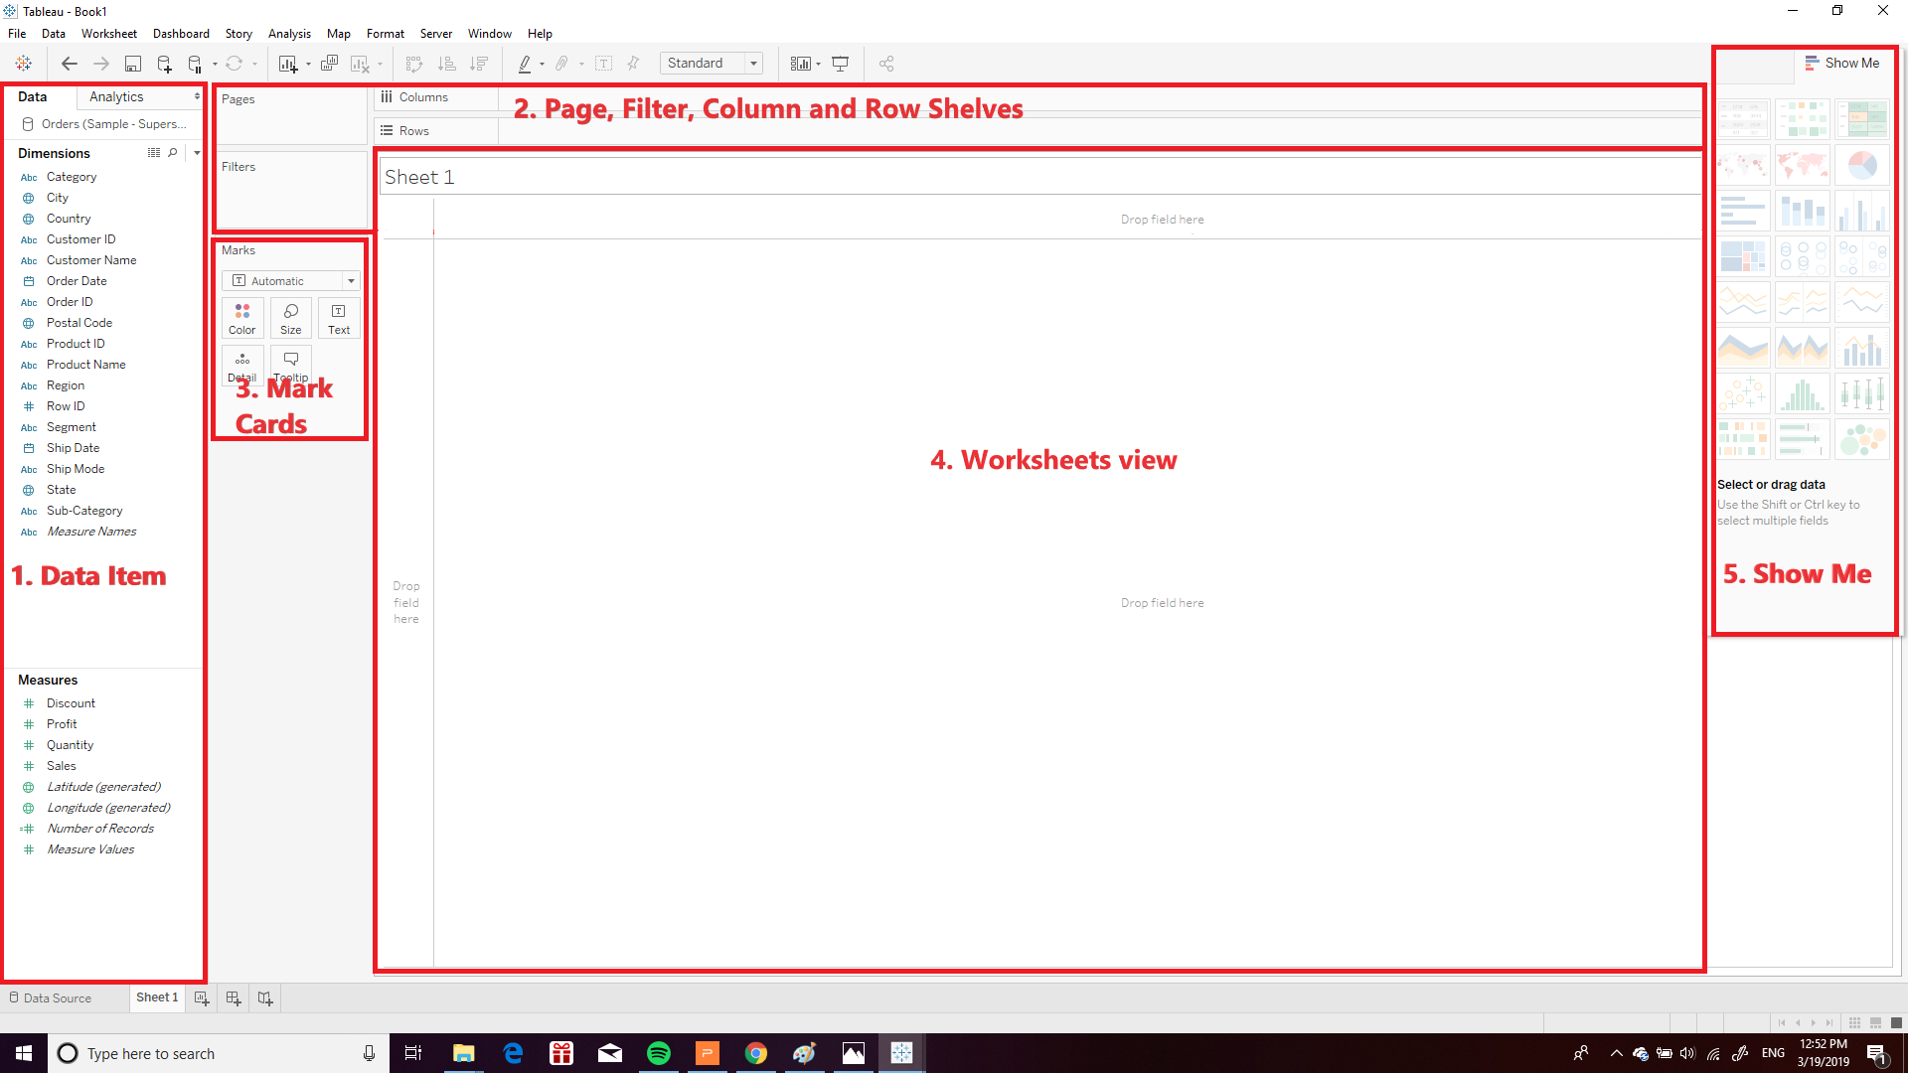
Basic View
Step1 : Open Super Store.twb or Super Store.twbx file
will show workspace as below:
1. Data Items pane
2. Pages, Filters, Columns and Rows Shelves
3. Marks Card/s
4. Worksheet view, data view, or view
5. Show Me dialog

Slide 27
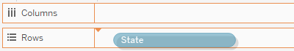
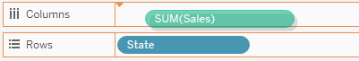
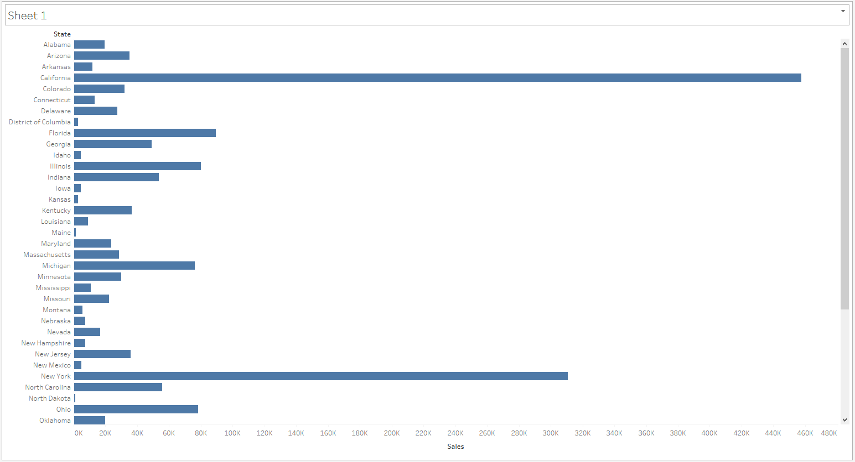
Step2 : Drag State dimension to Rows
Step3 : Drag Sales Measures to Columns
Worksheet view will be show chart as below:

Slide 28
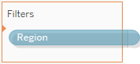
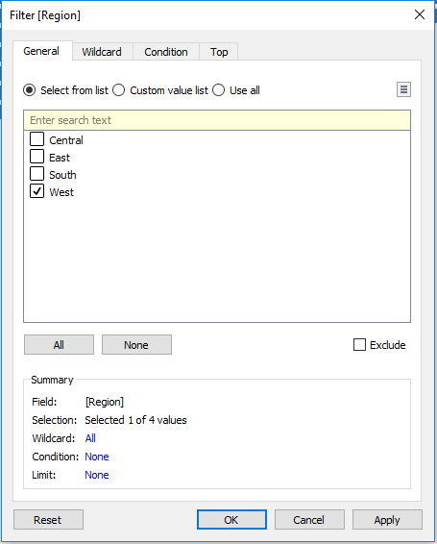
Filter Data
Step1 : Drag region dimension to Filter
Step2 : when filter windows show, select West value by checked the West Check box and then click ok

Slide 29
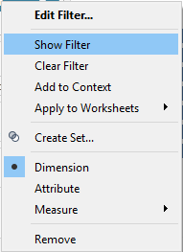
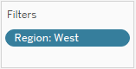
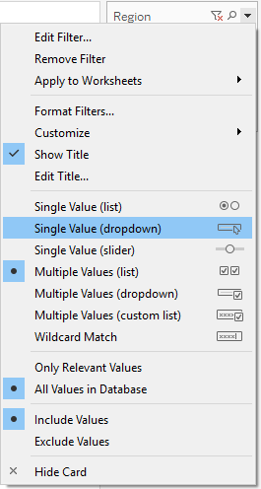
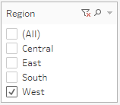
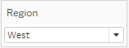
Show Filter
Step3 : right click on region filter and then choose show filter
Step4 : right click button on region filter that was show and then choose single value (dropdown)

Slide 30
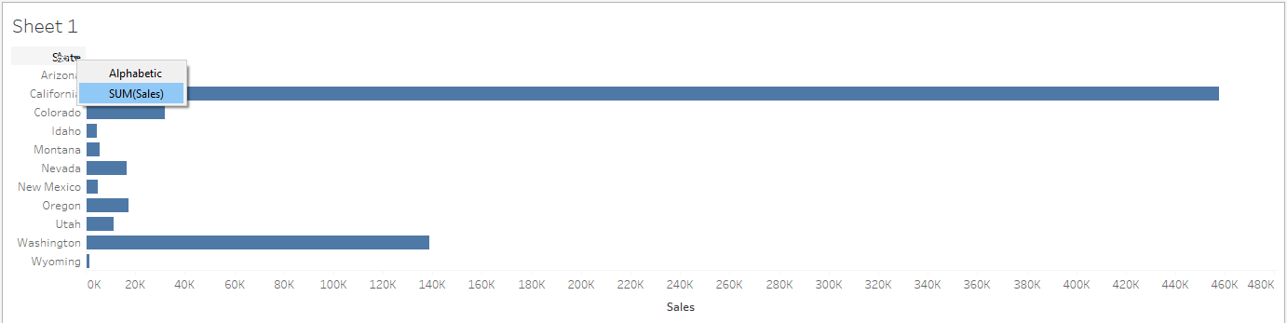
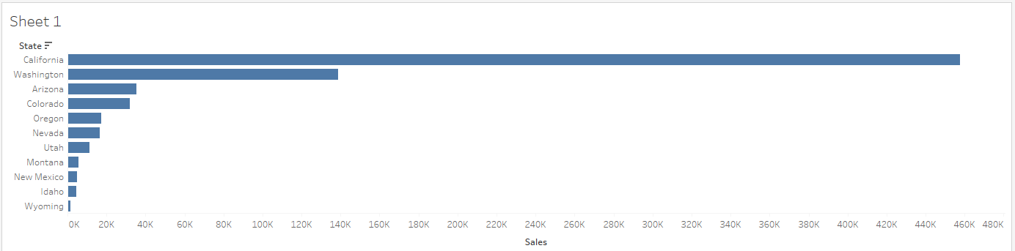
Sort Filter
Step1 : sort state base on sales by click on header of state and choose sum(sales)
Worksheet view will be show chart as below:

Slide 31
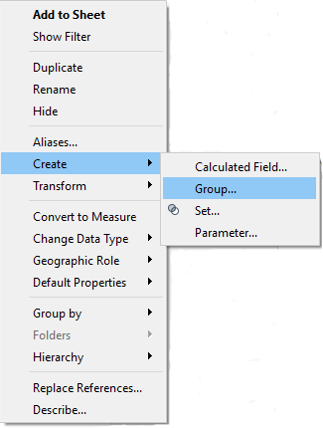
Grouping data
Step1 : Group ship class by Right click on Ship mode dimension hover to create and then select Group as below

Slide 32
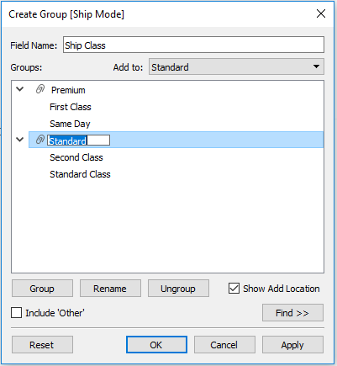
Step2 :
when group windows show, select on First Class value and then click group button and naming group as Premium after that drag Same Day value to Premium Group. do it same for value second class and standard class and naming group as standard. rename Field Name as Ship Class and click OK

Slide 33
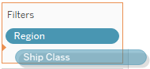
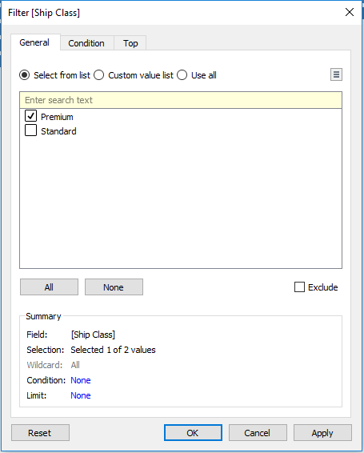
Step3 : Drag Ship Class dimension to Filter
Step4 : when filter windows show, select premium value by checked premium Check box and then click ok

Slide 34
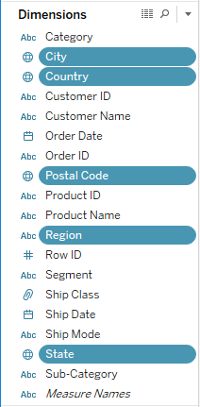
Creating Hierarchies
Step1 : Hold Ctrl + select dimension Country, Region, City, State, and Postal Code

Slide 35
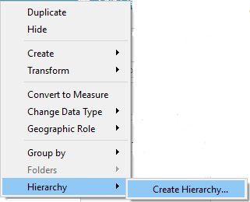
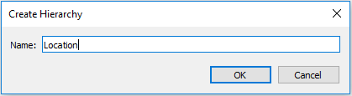
Step2 : Right Click on the selected dimension and go to Hierarchy and then Create Hierarchy
Step3 : when Create Hierarchy windows show naming hierarchy as Location and then click ok

Slide 36
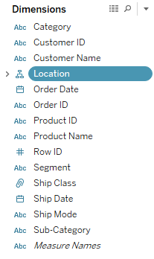
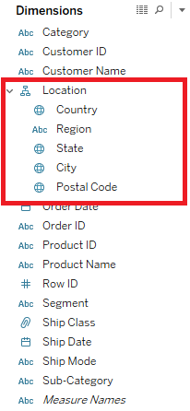
Location Hierarcy directly appear to the dimension.
the Hierarchy can expand to see all dimension in hirarchy and dimension inside can be sorted

Slide 37
CHAPTER 4
Measure Name and Measure Value

Slide 38
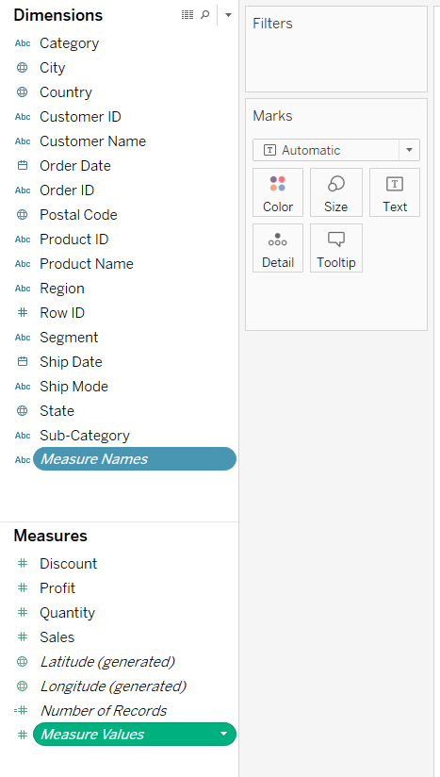
Measure Name and Measure value are field that tableau automatically creates to enable certain type analyses.
Measure Name
Measure Values field always appears at the bottom
of the Measures area in the Data pane and contains
all the measures in your data, collected into a single
field with continuous values
Measure Value
The Measure Names field always appears at the bottom
of the Dimensions area in the Data pane and contains
the names of all measures in your data, collected into a single
field with discrete values

Slide 39
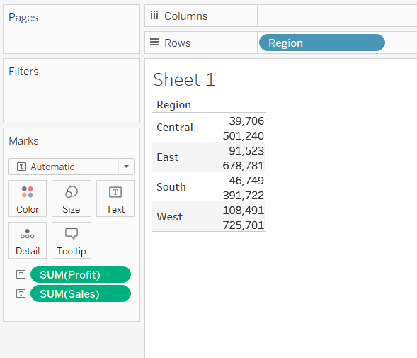
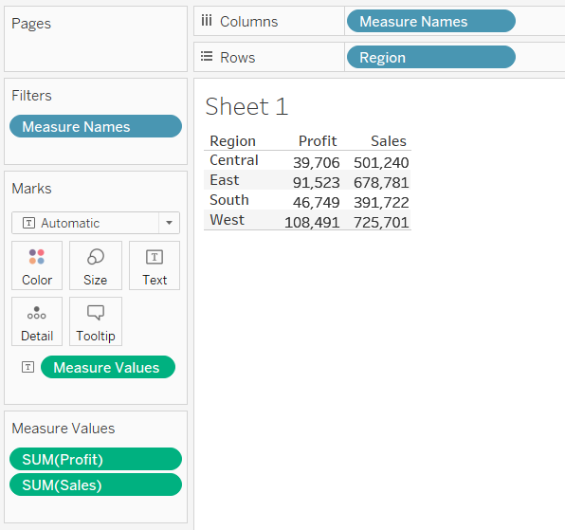
Without Using Measure Name and Measure value
Using Measure Name and Measure value

Slide 40
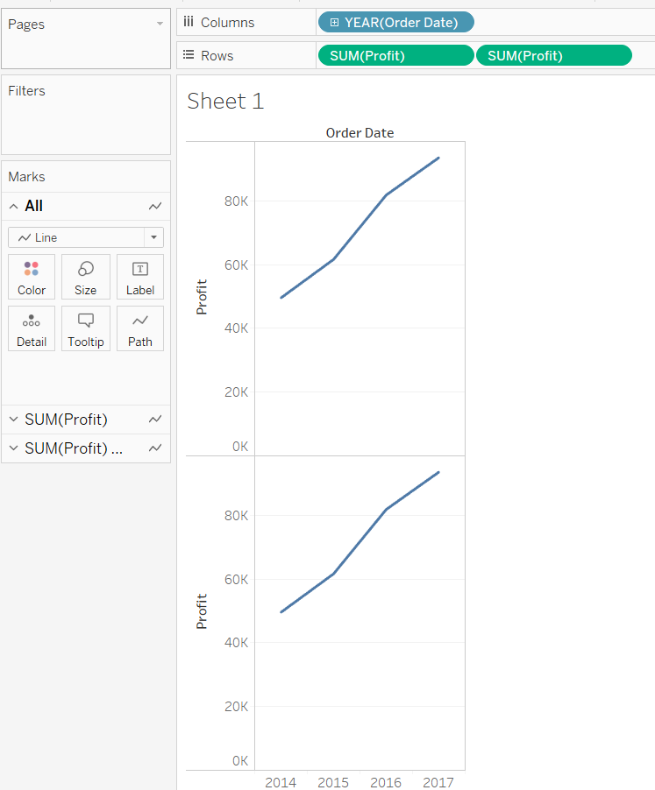
Add Axes for Multiple Measures in Views
To add individual axes for each measure,
Step : drag measures to the Rows
and dimension to the Columns shelves.
Adding a continuous field on the Rows shelf adds an additional axis to the rows of the table.
Adding a discrete field on the Columns shelf adds an additional axis to the columns of the table.

Slide 41
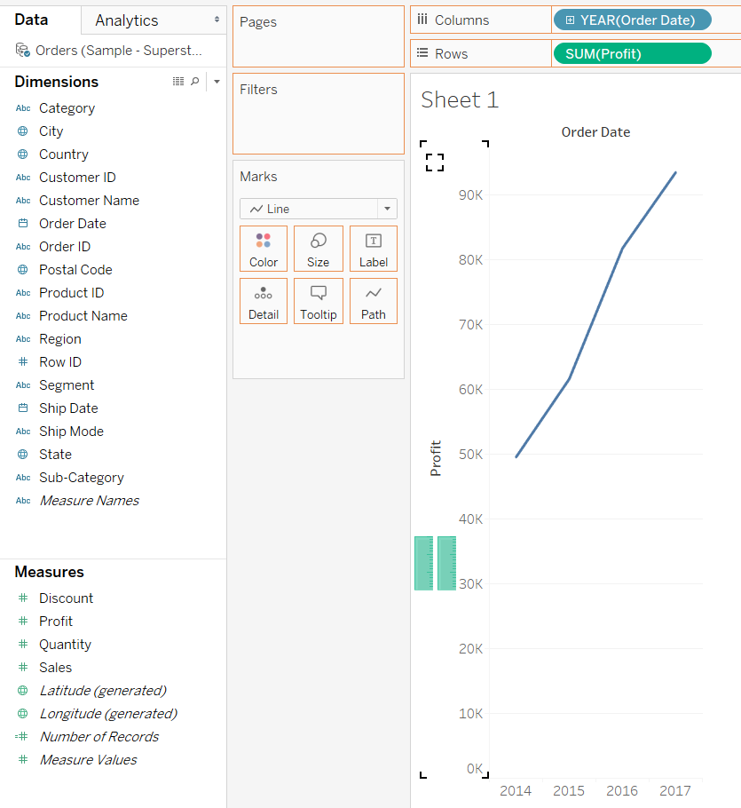
Blend axes for multiple measures into a single axis
Measures can share a single axis so that all the marks are shown in a single pane.
Step: drag one measure or axis and drop it onto an existing axis.
when you blend measures there is a single row or column and all of the values for each measure is shown along one continuous axis

Slide 42
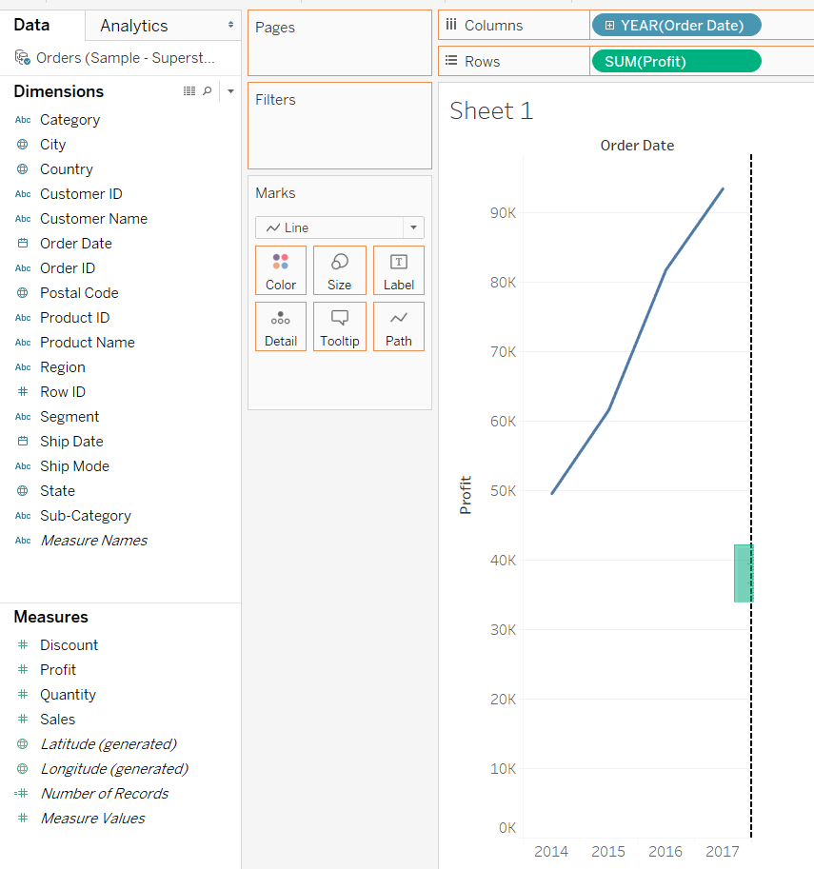
Compare two measures using dual axes
You can compare multiple measures using dual axes. Dual axes are useful for analyzing two measures with different scales.
Step : drag the field to the right side of the view and drop it when you see a black dashed line appear.

Slide 43
CHAPTER 5
Customizing Data

Slide 44
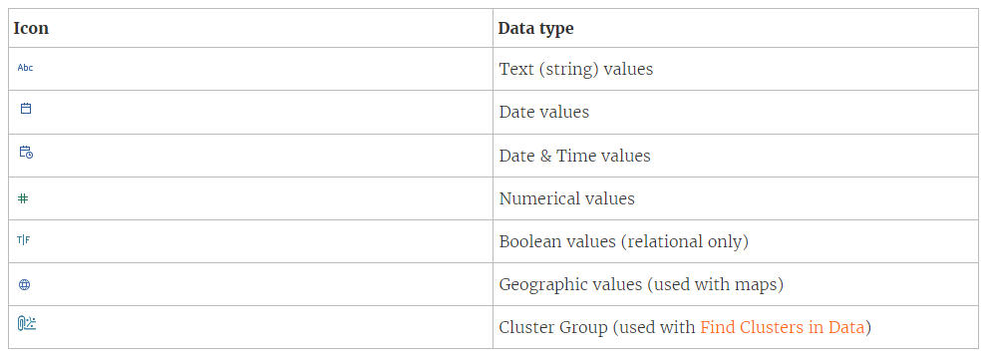
Data Type
The data type reflects the kind of information stored in that field, for example integers (410), dates (1/23/2015) and strings (“Wisconsin”)
Data type icons in Tableau

Slide 45
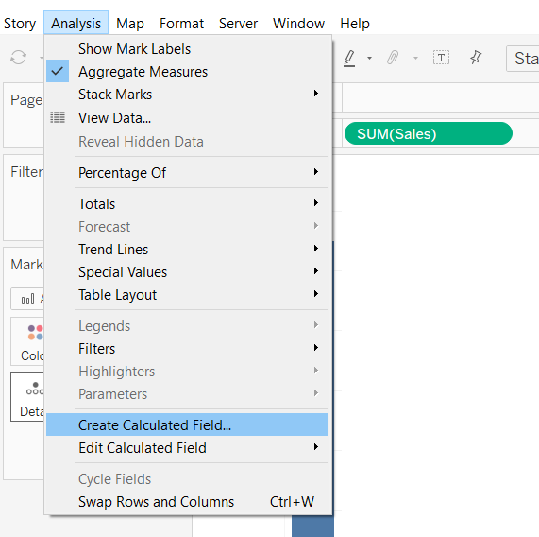
Numerical Function
Number functions allow you to perform computations on the data values in your fields. Number functions can only be used with fields that contain numerical values.
Following are the way to use “Number” functions in tableau:
1. On worksheet select Analysis > Create Calculated Field.

Slide 46
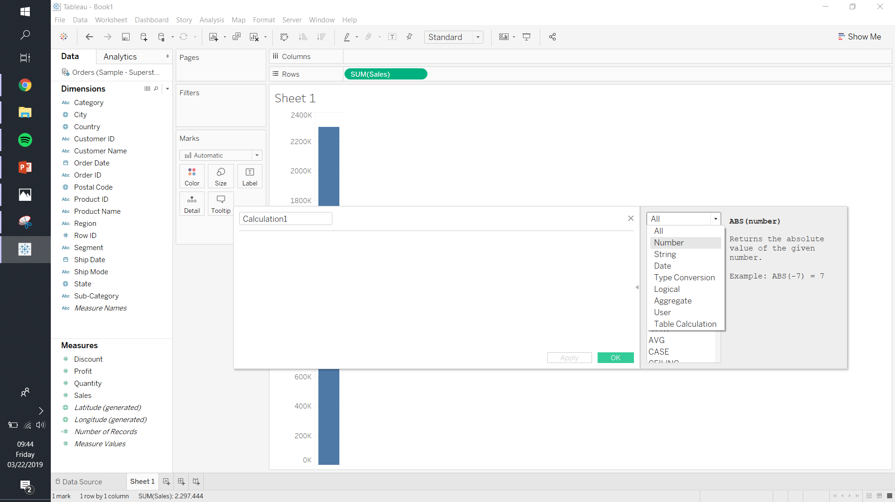
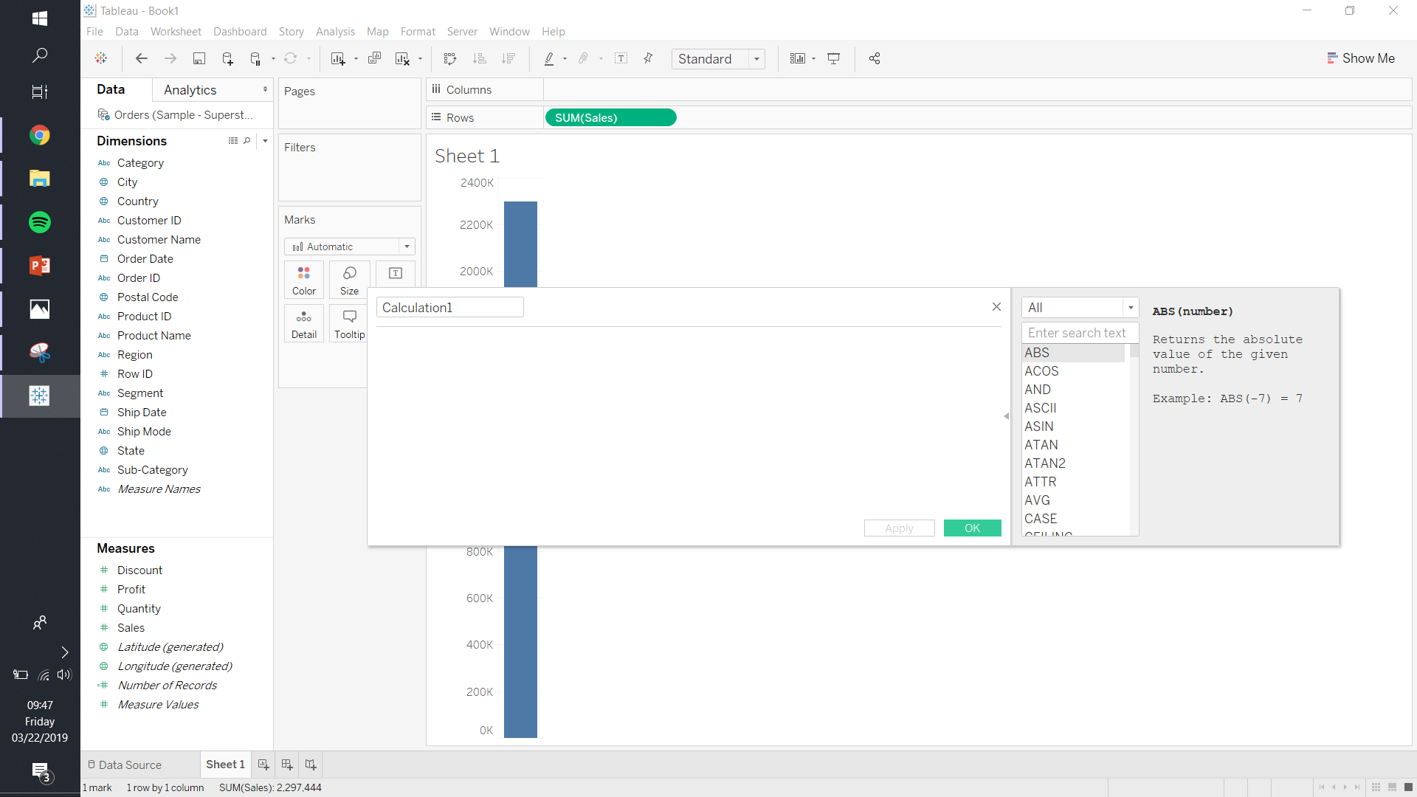
2. On Calculated Field select Number function. It will show you number function only.
Following are the some of the commonly used “Number” functions:
ABS
CEILING
FLOOR
MIN
MAX
SQRT
ZN

Slide 47
String Function
String functions allow you to manipulate string data (i.e. data made of text).
For example, from customer name field you might have a field that contains all of your customers' first and last names. You can pull the last names from all your customers into a new field using a string function.
The calculation might look something like this:
Following are the some of the commonly used “String” functions:
SPLIT
LEFT
LEN
LOWER
MID
REPLACE
RIGHT
TRIM
UPPER

Slide 48


Logical Function
Logical calculations allow you to determine if a certain condition is true or false (boolean logic). For example, you might want to quickly see if sales for each country you distribute your merchandise to were above or below a certain threshold.
The logical calculation might look something like this:
Following are the some of the commonly used “String” functions:
AND
CASE
IF-ELSE
OR

Slide 49
CHAPTER 6
Chart Forms

Slide 50

Bar Chart

Slide 51
Bar Chart
Bar charts represent numeric values as a bar and split across clear categories. Bar chart very effective for comparing information, and spotting highs and low in the data.

Slide 52

How to do it..
The following step to create bar chart:
From Dimension, drag Sub-Category to Rows
From Measure, drag Sales to Columns
Drag Sub-Category to filter top 5 by Sum Sales

Slide 53

Stacked Chart

Slide 54
Stacked Chart
Stacked bar charts, like regular bar charts, represent numeric values as segmented bars, and each bar is as specific category. This bar also effective for comparing information, and spotting highs and low in the data.

Slide 55

How to do it..
The following step to create stacked bar chart:
From Dimension, drag Order Date to Rows, then drill down until Month
From Measure, drag Sales to Columns
Drag Category to Color in Mark Card

Slide 56

Line Chart

Slide 57
Line Chart
A line chart often represents trend overtime, and typically requires numeric values plotted as lines over date-related fields. In this recipe, we will create a time series graph(or line chart) that shows the number off sales and profit over time

Slide 58

How to do it..
The following step to create line chart:
From Dimension, drag Order Date to Columns, then drill down until Month
From Measure, drag Sales to Rows
From Measure, drag Profit to Profit’s axis for blending the line

Slide 59

Scatterplots Chart

Slide 60
Scatterplots Chart
Scatter plots allow us to see the relationship between two variables, and are great for visualizing clusters, showing possible correlations, and spotting outliers. Scatter plots require measures (numeric values) on both the vertical and horizontal axes.

Slide 61

How to do it..
The following step to create Scatter plot chart:
From Measure, drag Quantity to Columns
From Measure, drag Discounts to Rows
From Dimension, drag sub-category to color in mark card
Select Analysis, trend line, and checklist show trend line

Slide 62

Heat Map

Slide 63
Heat Map
Heat maps are graphs that display information using a matrix of colours. Often the density of colour in the matrix represents the concentration of information. Heat maps are great for spotting patterns based on the concentration or density of information

Slide 64

How to do it..
The following step to create heat map chart:
From Dimension, drag Order Date to Columns, then drill down until Month
From Dimension, drag Sub-category to Rows
From Measure, drag quantity to color in mark card
the darkest color means the often density

Slide 65

Text Table (Crosstab)

Slide 66
Text Table (Crosstab)
A text table is a series of rows and columns that have headers and numeric values. Text tables are great when the audience requires to see the individual values

Slide 67

How to do it..
The following step to create Text Table:
From Dimension, drag Product Name1 and Order Date to Rows
From Dimension, drag Measure Names into filter then checklist measure you want to show. Then press Ctrl while shifting product name in filter to Columns
From Measure, drag Measure Value to Text in mark card
From Dimension, drag order date into filter then checklist last 2 year
From Dimension, drag product name into filter then choose top.

Slide 68

Highlight Tab

Slide 69
Highlight Tab
Highlight tables represent tabular information in a color-coded grid. The background colour of the individual cells corresponds to the relative magnitude of the value it represents. Highlight tables are great when displaying the actual numeric values are important, but you also want the visual emphasis by adding the background colours on the cells.

Slide 70

How to do it..
The following step to create Highlight Tab:
From Dimension, drag Product Name1 and Order Date to Rows
From Dimension, drag Measure Names into filter then checklist measure you want to show. Then press Ctrl while shifting product name in filter to Columns
From Measure, drag Measure Value to Text in mark card
From Dimension, drag order date into filter then checklist last 2 year
From Dimension, drag product name into filter then choose top 10 by sum quantity.
From Dimension, drag profit to color in mark card. Then change the mark to a Square.

Slide 71

Pie Chart

Slide 72
Pie Chart
A pie chart is a circle that is sliced. Each slice is identified using a different colour and/or label. The size or angle of the slice represents that item or category’s proportion. Pie charts are best at showing part relationships when there aren’t too many slices.

Slide 73


How to do it..
The following step to create Pie Chart:
Change the Mark type into Pie in Marks Card
From Measures, drag Sales into angel in Marks Card
From Dimensions, drag Product Name to Colors in Mark card.
Right-click on Product Name in the Colors property in the Marks card and select Filter.
In the Top tab, select By field: Top and 5 by Sum of Sales.

Slide 74

Tree Map

Slide 75
Tree Map
Tree maps represent part-to-whole and hierarchical relationships using a series of rectangles. The sizes and colors of rectangles will vary based on the values they represent. Typically, the larger rectangles, or rectangles with most concentrated colors, depict the highest values.

Slide 76

How to do it..
The following step to create Tree Map:
From Dimensions, drag order date into filter then choose only 2017 in year
Change the Mark type into Square in Marks Card
From Measures, drag Quantity into Size in Marks Card
From Dimensions, drag Region to Colors in Mark card.
From Dimensions, drag Sub-Category to Text in Mark card.
From Measure, drag Quantity to Text in Mark card.

Slide 77

Donut Chart

Slide 78
Donut Map
A donut chart, like a pie chart, shows part-to-whole relationships. And like a traditional donut, it has a hole in the middle.

Slide 79
How to do it..
The following step to create Donut Chart:
Change the Mark type into Pie in Marks Card
From Measures, drag Number of record into Rows. Do it twice
Right click in one of Number of record then choose dual axis
From the second MIN(Number of record), change Color to white
From the second MIN(Number of record), make size less then first MIN(Number of record)
From Dimensions, drag Product Name to Colors in Mark card.
Right-click on Product Name in the Colors property in the Marks card and select Filter.
From Measures, drag Sales to angle in Mark card

Slide 80
QUIZ DADAKAN
Saat ini salah satu Club sepak bolah sedang menghitung performance pemain berdasarkan jumlah goal yang dicetak pada season lalu. Pemain sepak bola hanya di kategorikan Pemain tengah (MID) dan pemain depan (FWD). Dari semua pemain hanya Frank Lampard, Gary Speed, Steven Gerrard, Paul Scholes, Ryan Giggs yang merupakan pemain tengah.
(1 season terdiri dari 5 tahun, season kemarin tidak termasuk tahun ini (tahun ini 2016))
Pertanyaan :
Siapakah dari semua pemain yang mendapatkan penghargaan sebagai pemain dengan cetak goal terbanyak?
Siapakan pemain tengah yang mendapatkan penghargaan sebagai pemain dengan cetak goal terbanyak?
Siapakah pemain depan yang mendapatkan penghargaan sebagai pemain dengan cetak goal terbanyak?
Jika ada penghargaan pemain terbaik, yaitu pemain yang mendapatkan dua penghargaan. Siapakan pemain tersebut?

